Slide 1
Debate, Discuss, Persuade

Slide 2

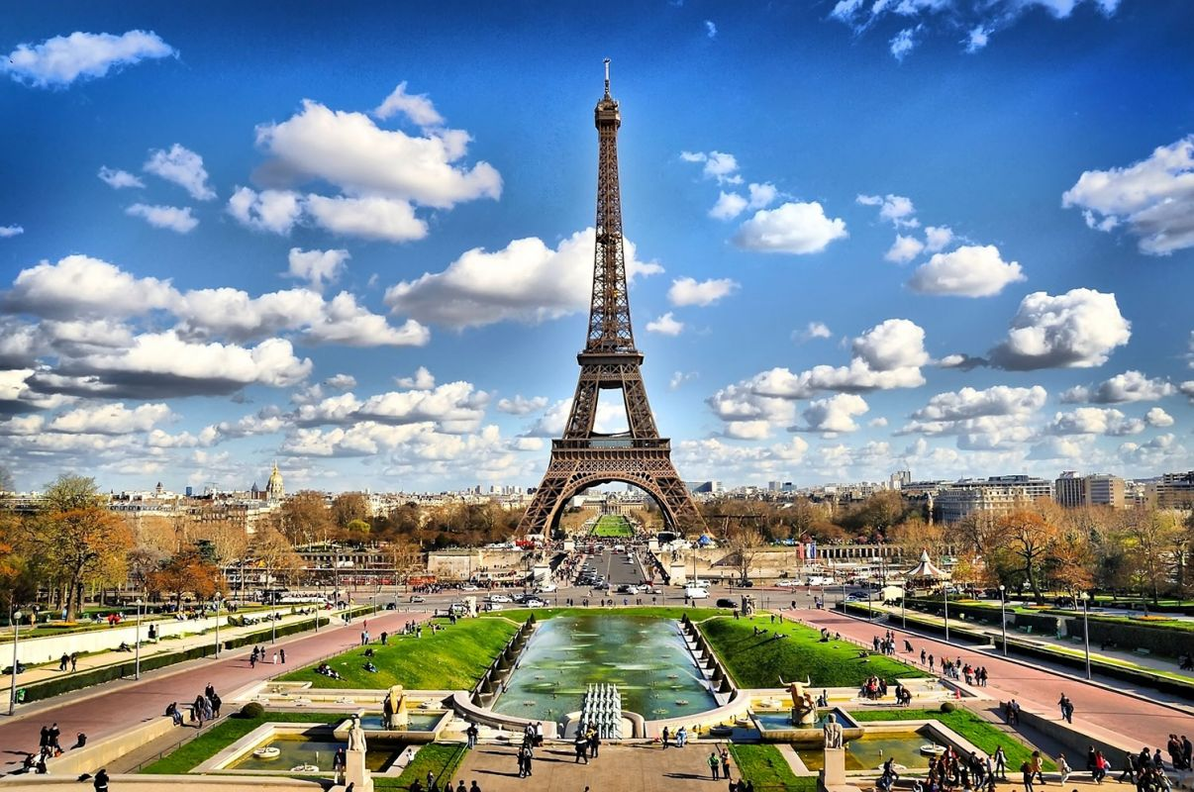
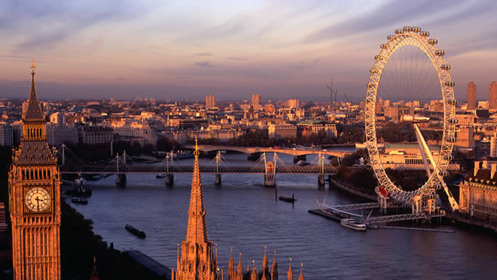

Choose a place for the school end of year trip. Persuade the headmaster that your idea is the best.

Slide 3

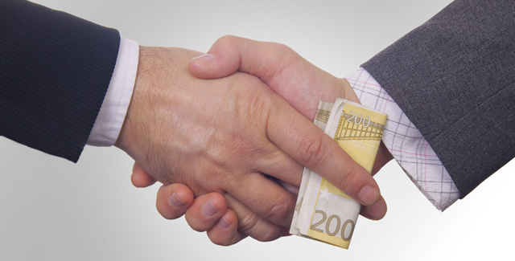
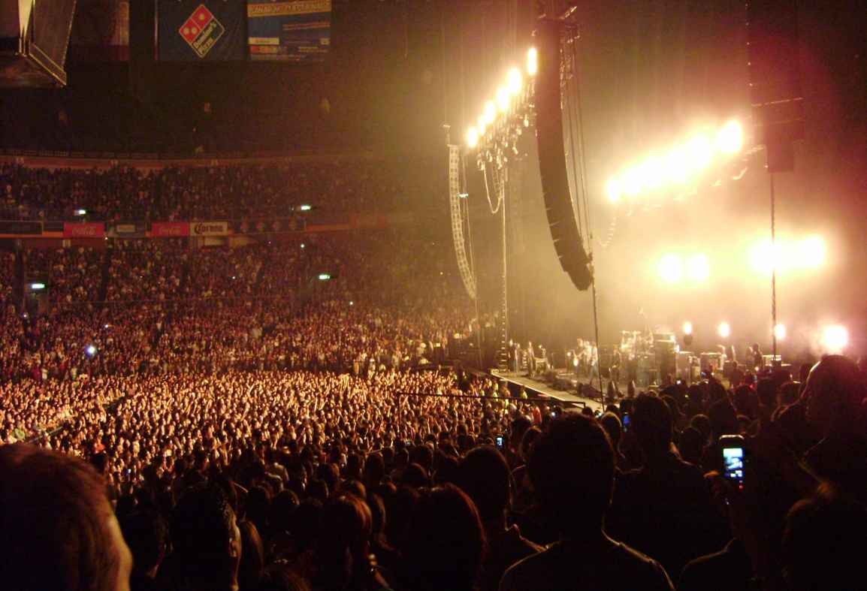

You’re a journalist, you’ve written an article about one of these topics, convince the editor to put yours on the front page.

Slide 4
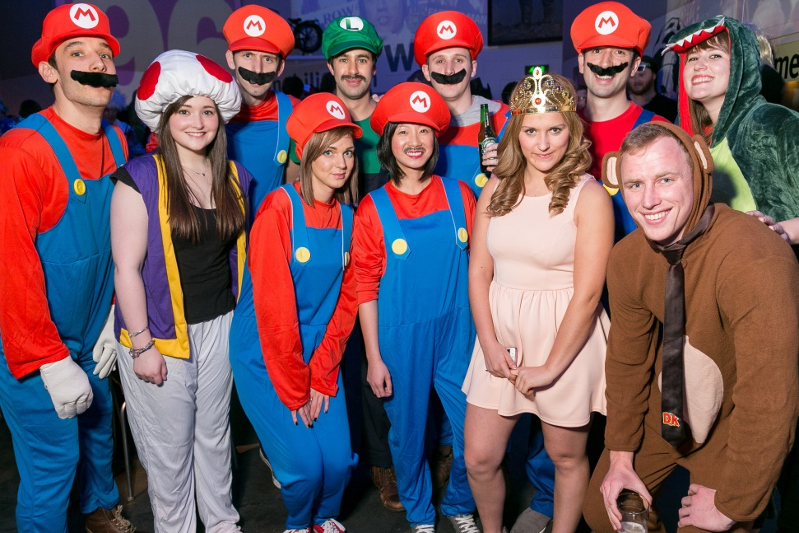


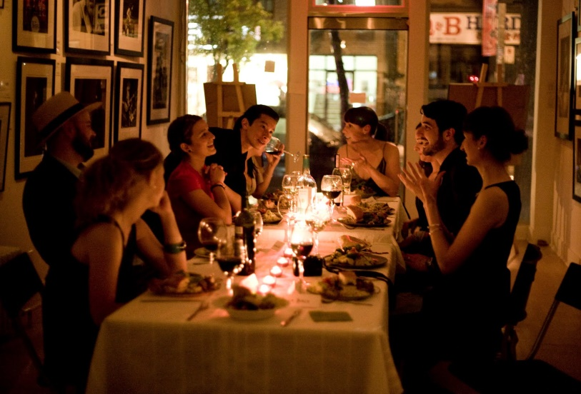
You’re organising a surprise party for a friend, convince your group that your idea is the best.

Slide 5

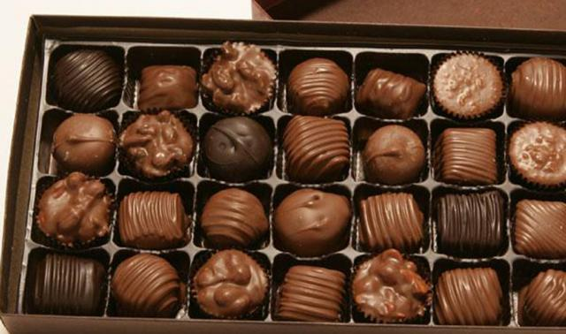
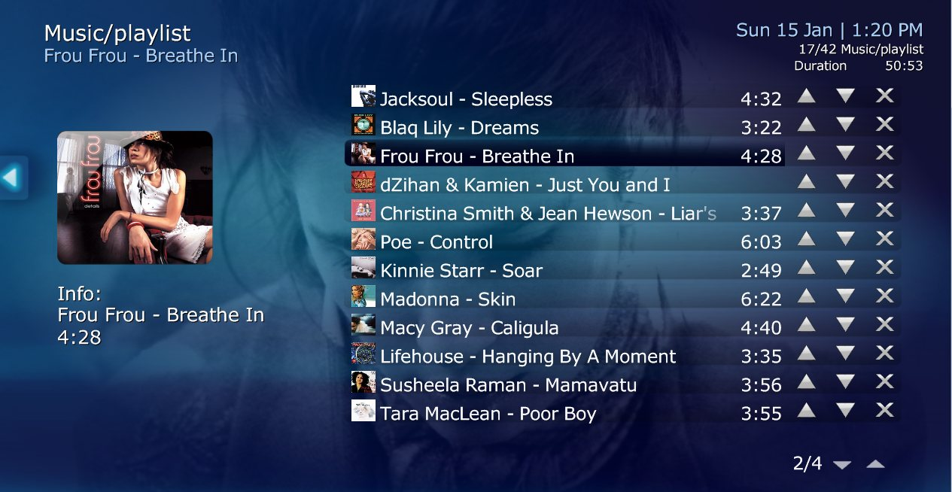

Your friend needs to buy a present for his girlfriend. Convince him that your idea is the best.

Slide 6
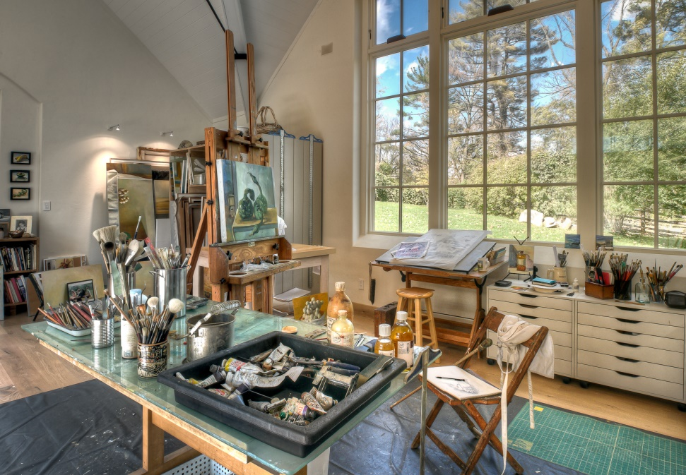
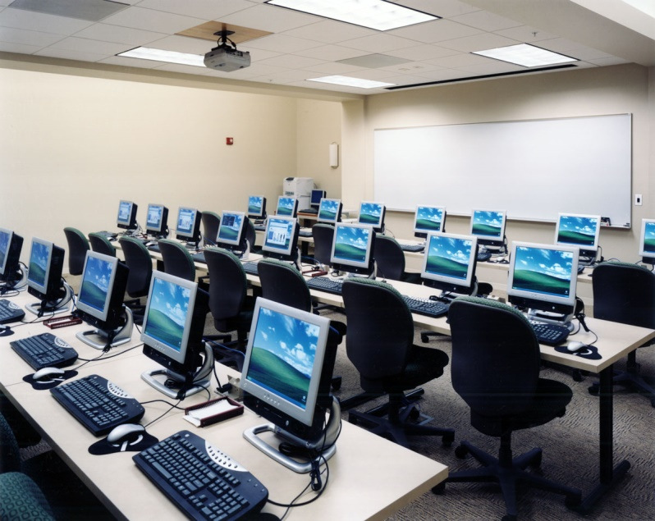

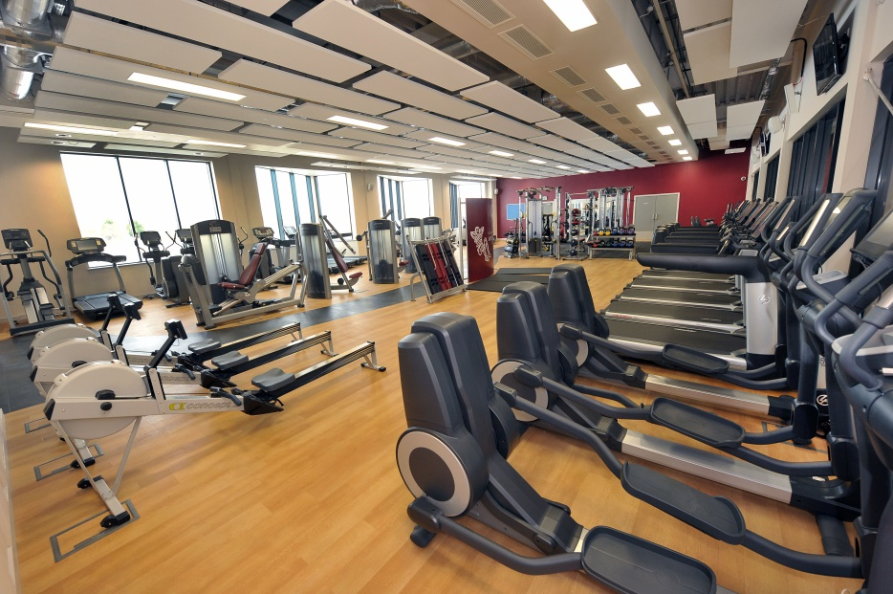
Your school has been given some money, convince the headmaster that your idea for spending it is the best.

Slide 7
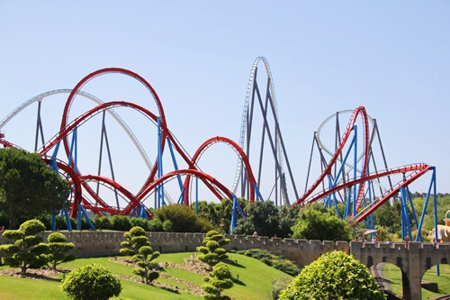
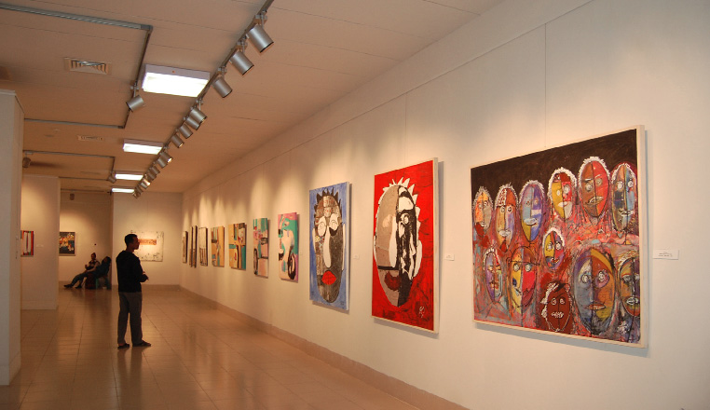

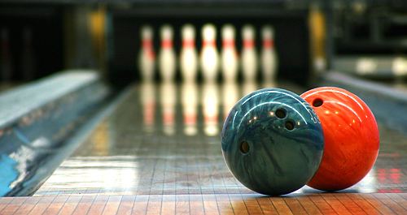
Your parents are deciding where to go this Saturday, persuade them that your idea is best.

Slide 8
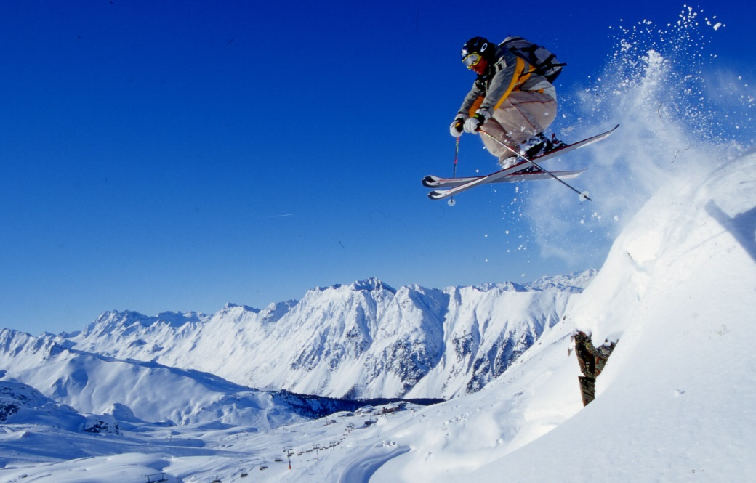
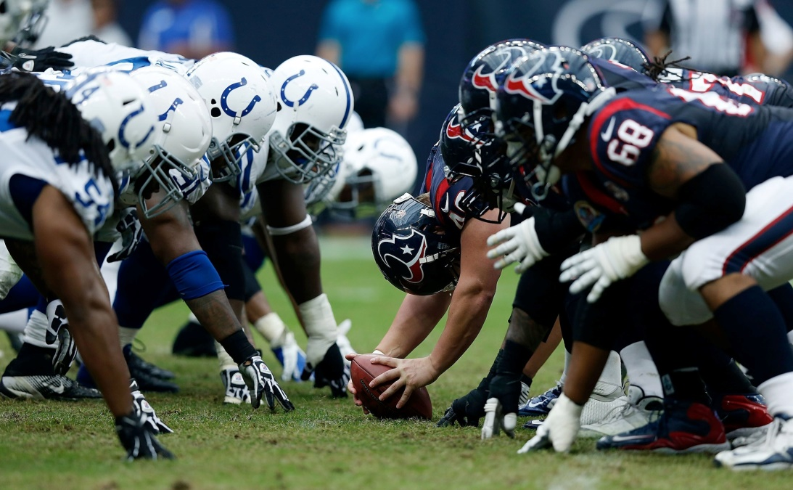

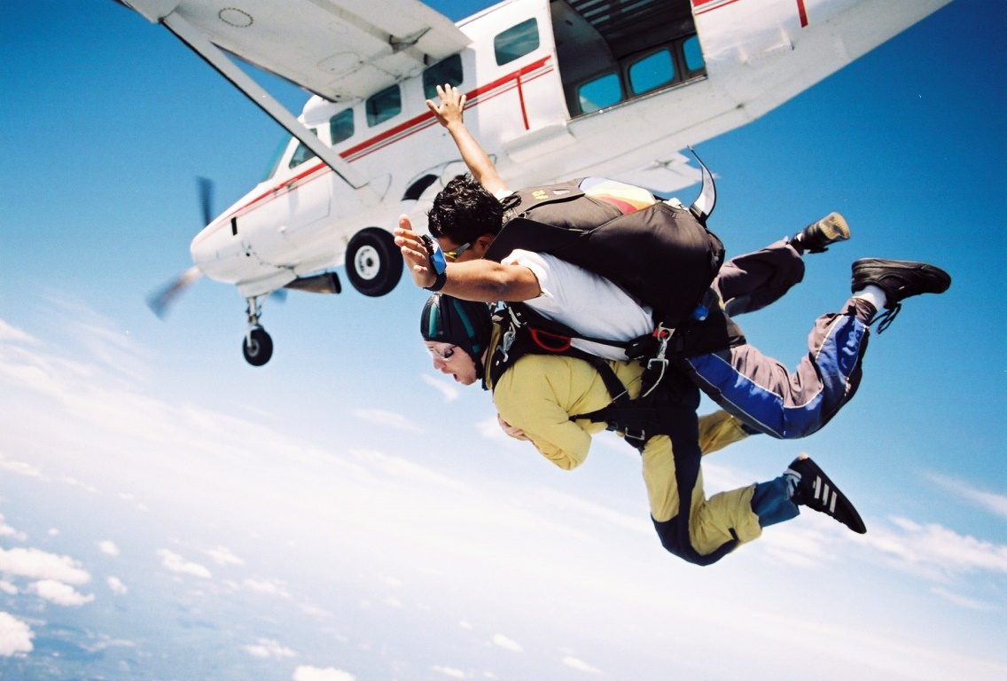
You have just started a new sports magazine, convince your boss to use your photo on the front page.

